Slide 1
Classification of brain tumors in weakly annotated histopathology images with deep learning
Thesis defence presentation
Dávid Hrabovszki
2021.05.31.

Slide 2
The aim is to classify two different grades of brain tumor from whole slide histology images using deep learning, where pixel-level annotation is unavailable.
Supervisor: Anders Eklund
External supervisor: Neda Haj Hosseini
Department: Biomedical Engineering (IMT), US Campus

Slide 3
Background
Pathology: studies diseases and helps with diagnosis
Histology: studies the microscopic anatomy of biological tissues
Whole Slide Images (WSI): digitized tissue slides under a microscope
Brain tumor grades according to WHO increase in malignancy:
I
II
III
IV
Binary classification (expert task, that can be helped with DL)
Lower Grade Glioma (LGG)
Glioblastoma Multiforme (GBM)

Slide 4
Data
The Cancer Genome Atlas (TCGA) https://portal.gdc.cancer.gov
1704 Whole Slide Images, on average 800 MB each
2 classes: GBM (860 WSIs) – LGG (844 WSIs)
e.g. 100,000 x 50,000 pixels
359 too large images (> 8 GP) are excluded, because they do not fit into memory
220 WSIs sampled for analysis (to lower processing time)
26 WSIs are excluded because of data quality issues (out of focus, pen marker)
Final dataset = 194 WSIs (97 from each class)
Images need to be divided into patches to feed to CNN

Slide 5
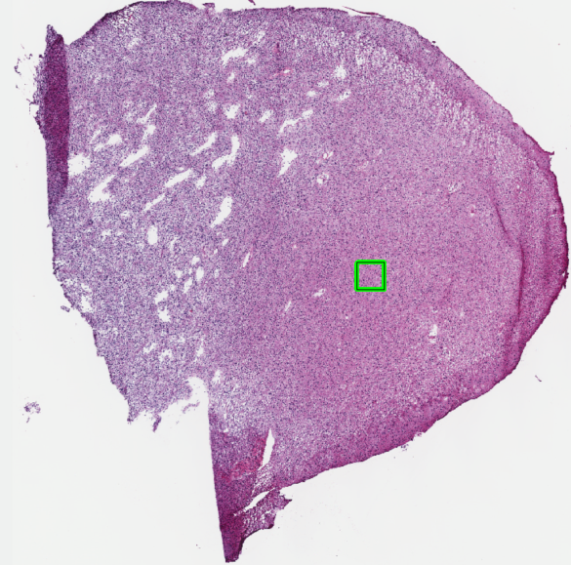
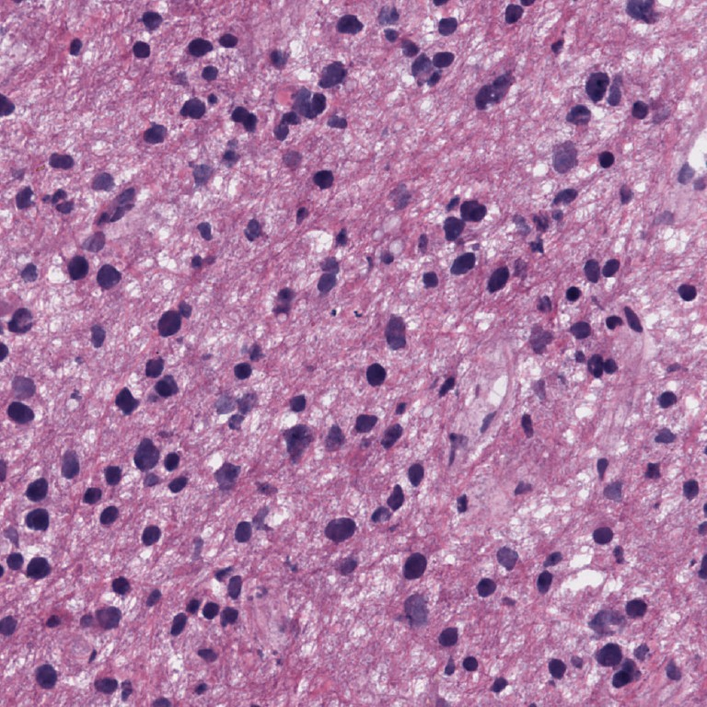
Example – Whole Slide Image (LGG class)
Patch extraction

Slide 6
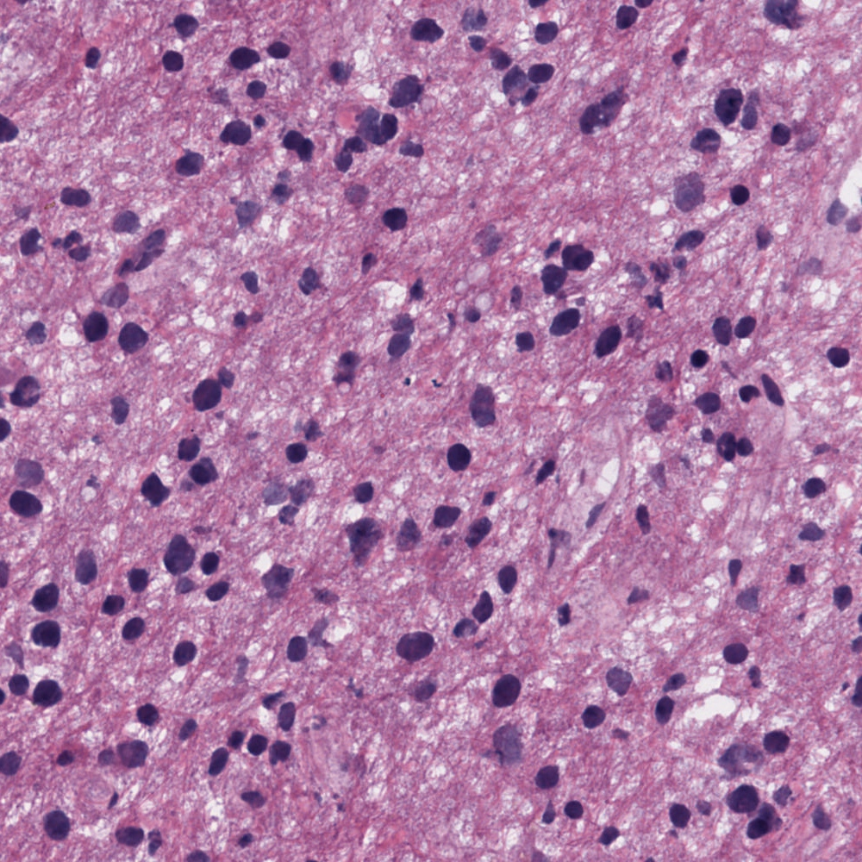
Example – One patch with visible cells and structures at 20x magnification (LGG class)

Slide 7
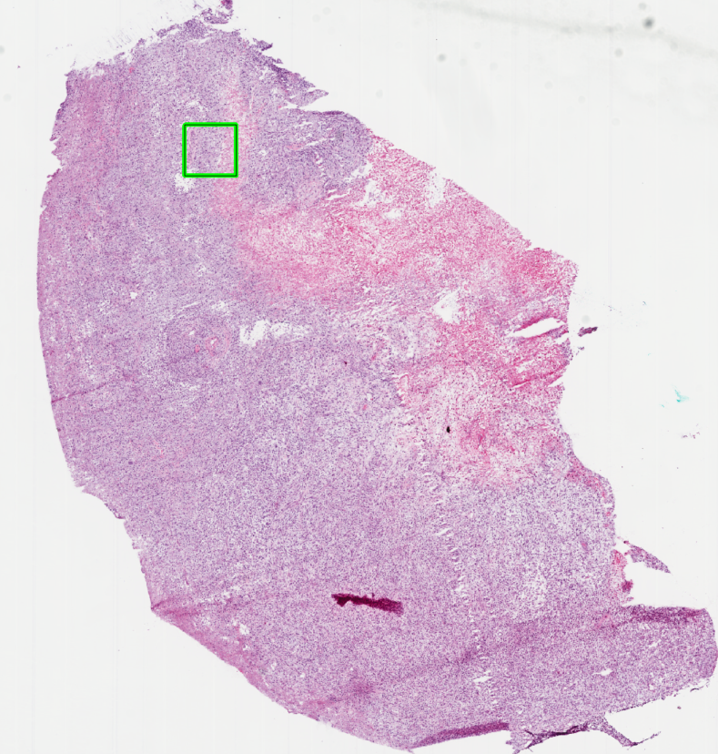
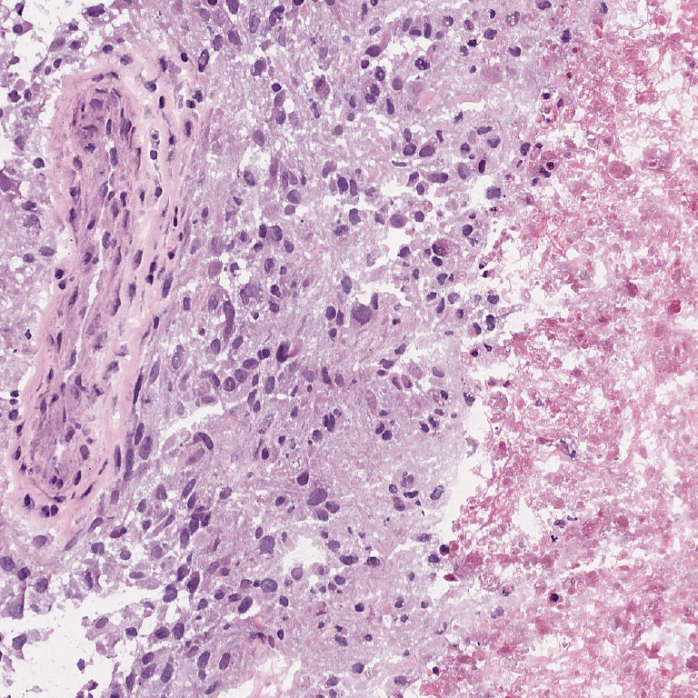
Example – Whole Slide Image (GBM class)
Patch extraction

Slide 8

Example – One patch with visible cells and structures at 20x magnification (GBM class)

Slide 9
Research questions
How well can a deep learning model classify whole slide images as glioblastoma or lower grade glioma with a slide-level annotation?
Is a pre-trained convolutional neural network significantly better than one trained from scratch?
Does image augmentation significantly improve classification performance?
What is the best approach for combining the patch-level predictions to a slide-level prediction?
Challenges:
Large images -> need to create patches
Slides come from different sources -> need to be normalized
No pixel level labeling (patches in a slide might be cancer-free or belong to the other class) -> need to find a way to aggregate predictions to slide level

Slide 10
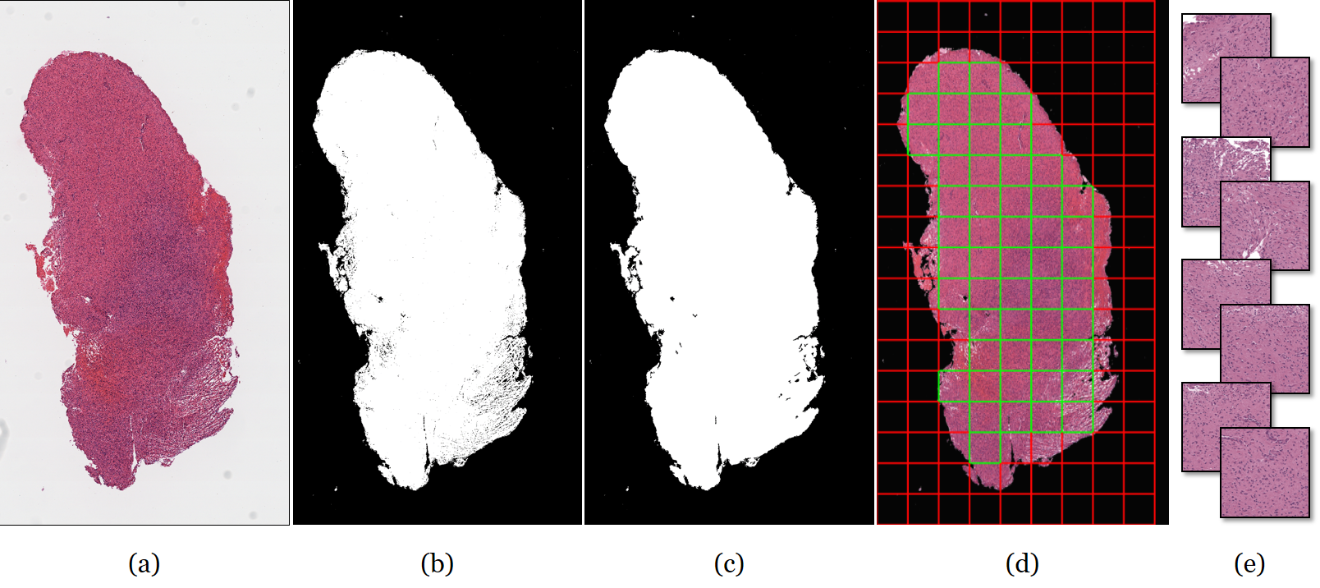
Preprocessing pipeline
Notes:
3 main areas of the thesis: preprocessing, patch-level modelling, slide aggregation.
Patches are extracted in two sizes (336 x 336, and 672 x 672).

Slide 11
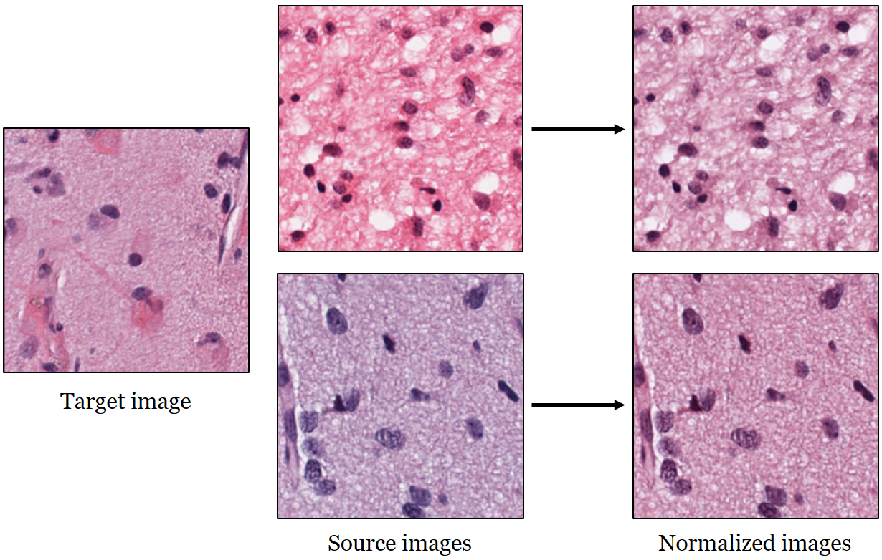
Preprocessing (stain color normalization)
Notes:
Stain color basis of the target image are mapped to the source images.

Slide 12
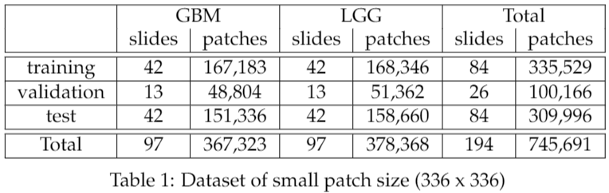
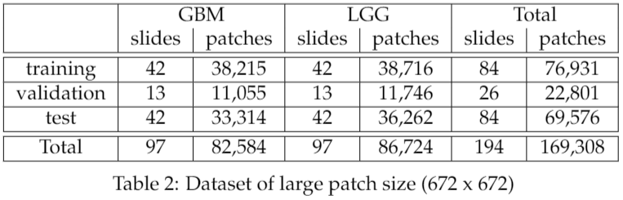
Preprocessing (resulting dataset)

Slide 13
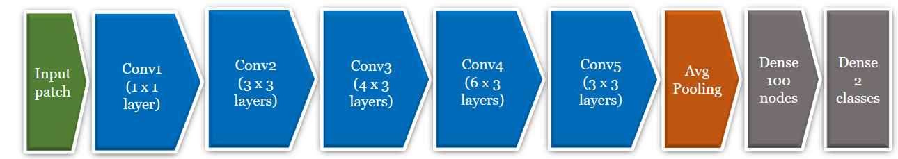
CNN as patch level classifier
A ResNet50-based convolutional neural network architecture was used as the patch classifier.
Feature learning with increasing pattern complexity
Classification
Dropout was active in dense layers both in training and test time for:
Regularization (reduce overfitting)
Monte Carlo dropout for uncertainty estimates of each prediction (30 samples)

Slide 14
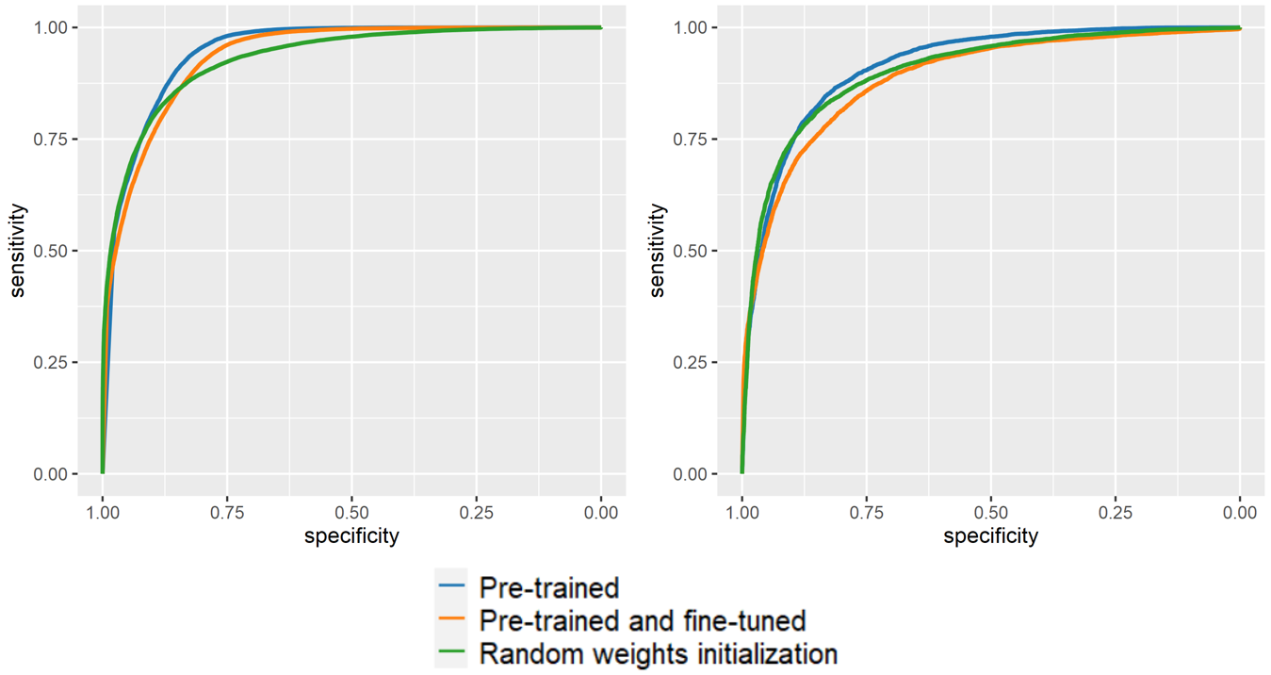
CNN model training 1/2 (pre-training approaches)
ROC curve for small patches
ROC curve for large patches
Notes:
Evaluated on the validation set on patch level. Compared with DeLong’s test for ROC curves. ImageNet contains images from 1000 classes (cars, planes, cat, dog, etc.)

Slide 15
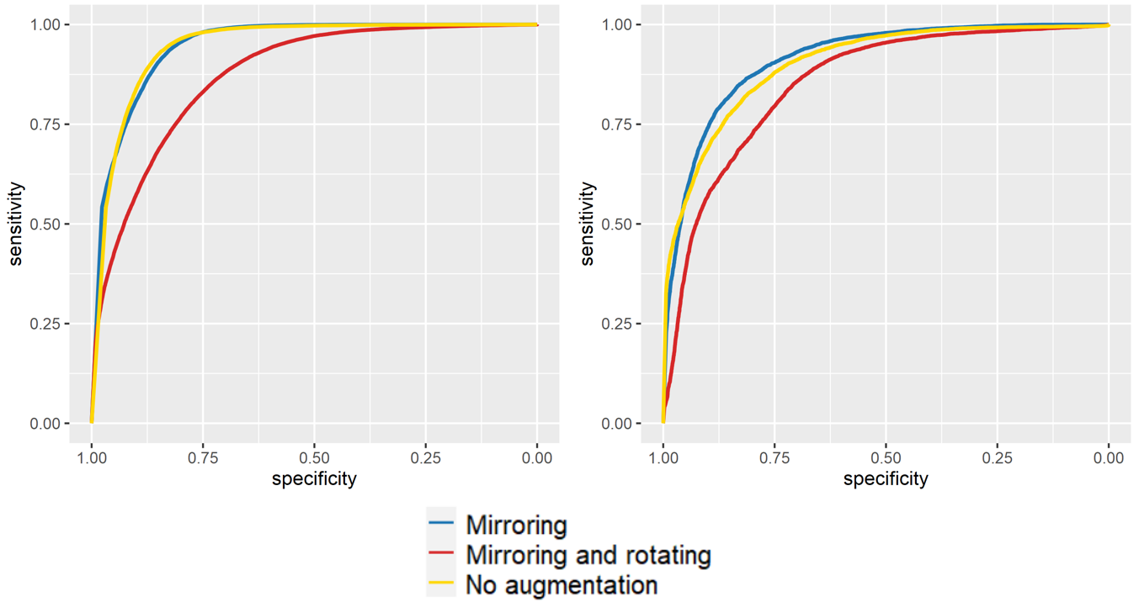
CNN model training 2/2 (data augmentation approaches)
ROC curve for small patches
ROC curve for large patches
Notes:
Evaluated on the validation set on patch level. Compared with DeLong’s test for ROC curves.

Slide 16
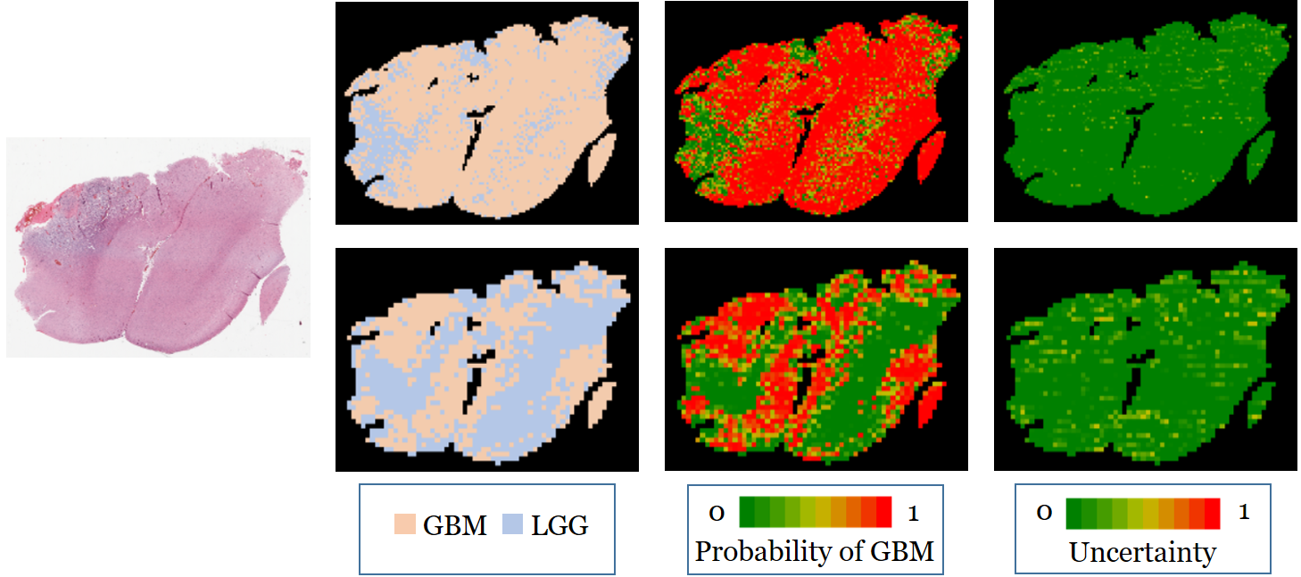
Patch level predictions (small & large patches)
Original GBM image
Notes:
2nd column: predicted classes
3rd column: predicted probabilities
4th column: prediction uncertainties
Top row: small patches
Bottom row: large patches

Slide 17
Slide aggregation methods (1/2)
Majority voting
Not how pathologists make decisions
Uncertainty is ignored, prediction is the ”average” of MC Dropout simulations
The probability of a slide being GBM is the ratio of the GBM patches
Logistic regression as 2nd level model
Features: Ratio of patches predicted GBM with >= 95% certainty
Ratio of patches predicted LGG with >= 95% certainty
Spatial smoothing: flipping uncertain patches based on spatial location + majority voting
GBM (certain) | GBM (certain) | GBM (certain)
GBM (certain) | LGG (UNCERTAIN) | GBM (certain)
GBM (certain) | GBM (certain) | GBM (certain)
GBM | GBM | GBM
GBM | GBM | GBM
GBM | GBM | GBM
Notes:
Logreg learnt on the validation set.

Slide 18
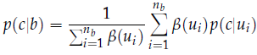
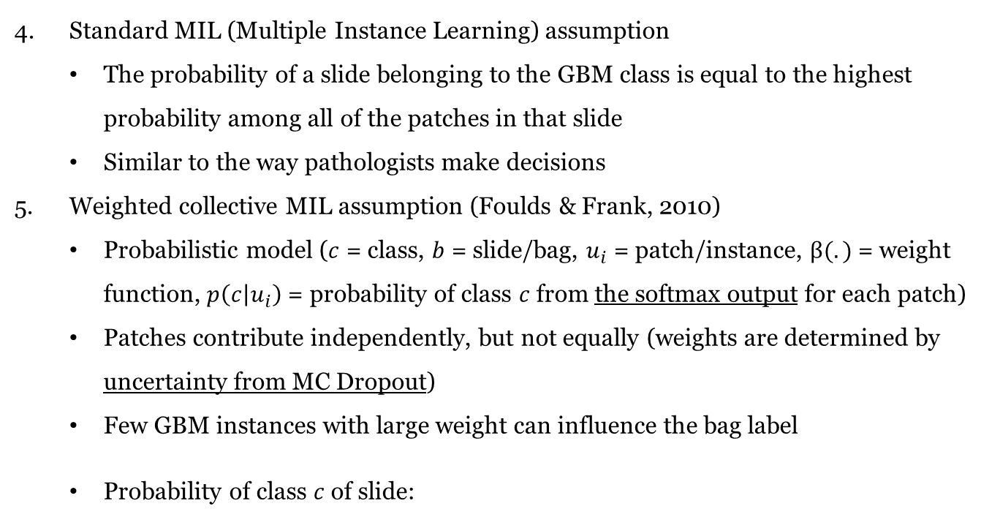
Slide aggregation methods (2/2)
Standard MIL (Multiple Instance Learning) assumption
The probability of a slide belonging to the GBM class is equal to the highest probability among all of the patches in that slide
Similar to the way pathologists make decisions
Weighted collective MIL assumption (Foulds & Frank, 2010)
Probabilistic model ($c$ = class, $b$ = slide/bag, $u_{i}$ = patch/instance, $β(.)$ = weight function, $p\left(c | u_{i}\right)$ = probability of class $c$ from the softmax output for each patch)
Patches contribute independently, but not equally (weights are determined by uncertainty from MC Dropout)
Few GBM instances with large weight can influence the bag label
Probability of class $c$ of slide:

Slide 19
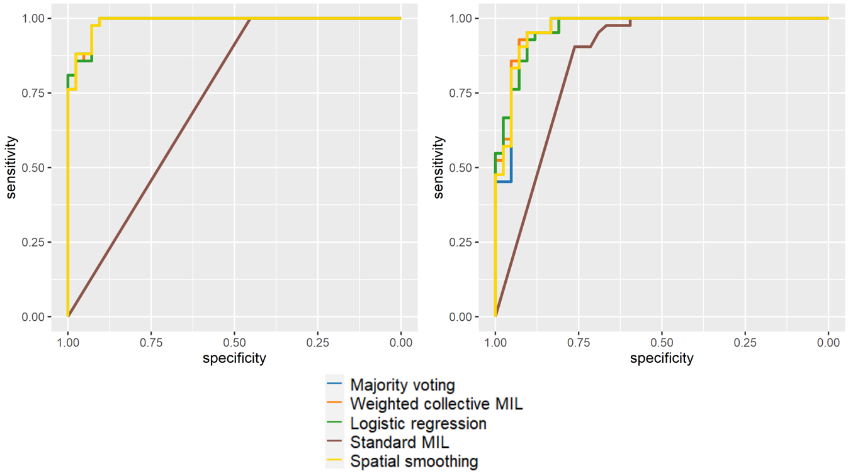
Slide aggregation results
Not significantly different (except for Standard MIL)
ROC curve for small patches
ROC curve for large patches
Notes:
Compared with DeLong’s test for ROC curves. Logreg features did not have a significant impact on the response variable -> more validation data would have been necessary.

Slide 20
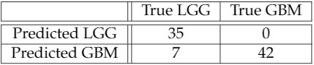
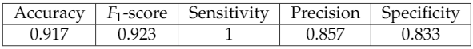
Conclusions
How well can a deep learning model classify whole slide images as glioblastoma or lower grade glioma with a slide-level annotation?
Is a pre-trained convolutional neural network significantly better than one trained from scratch?
Yes, but only if all the layers are trainable.
Does image augmentation significantly improve classification performance?
Yes, with mirroring augmentation (in large patches). No improvement from rotations.
What is the best approach for combining the patch-level predictions to a slide-level prediction?
No statistically sounds conclusion, due to small test set. (small patches, majority voting)
Notes:
Statistical insignificance
Future work
Precision = When it predicts yes, how often is it correct?
Sensitivity, recall = True Positive Rate
Specificity = True Negative Rate
F1-score = harmonic mean of the precision and recall

Slide 21
Thank you!

